Slide 1
DRAFTY

Slide 2
User Requirements
Decompose the Human Review logic and process from the identified NCPS application such that it runs as a stand-alone application capable of subscribing to an AMQP Topic to receive incoming STIX files that require human review, presenting files to users for editing using the existing logic and UI elements, and then publish approved/edited files to an AMQP topic.
Decompose the file ingest and dissemination logic and then create micro-services to perform that same logic in auto-scaling clusters.

Slide 3

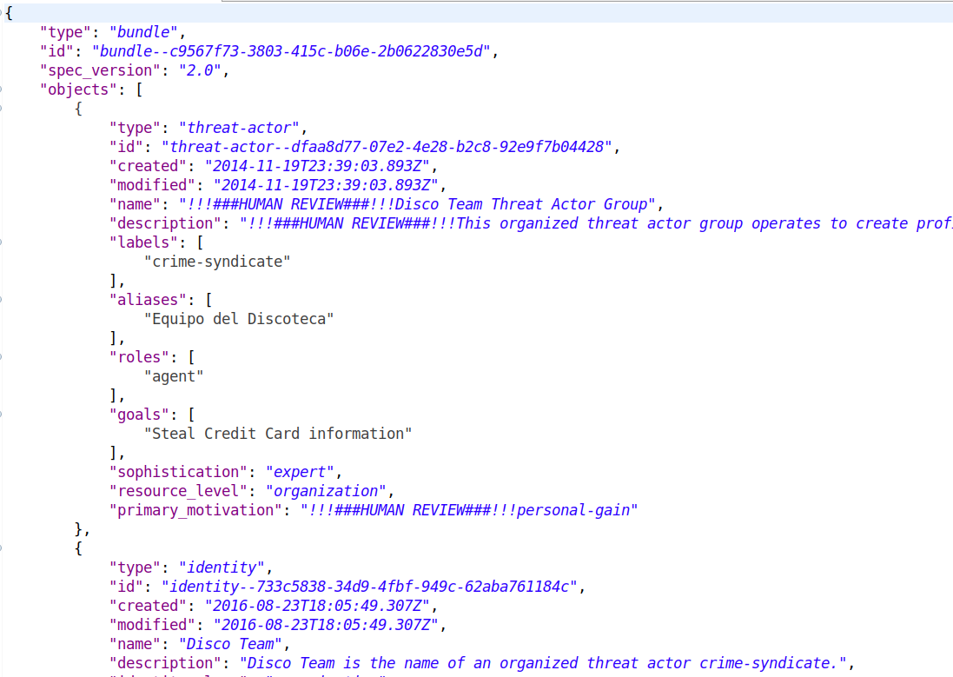
1
Active MQ
2
3
4
MySQL
HR UI
(NodeJS)
HR Backend (Spring Boot)
HR Partner
(Spring Boot)
5
6
Active MQ

Slide 4
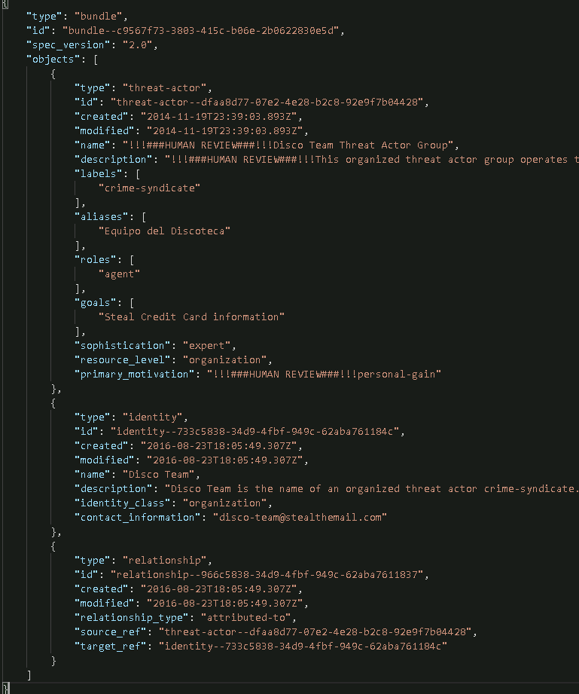

Slide 5
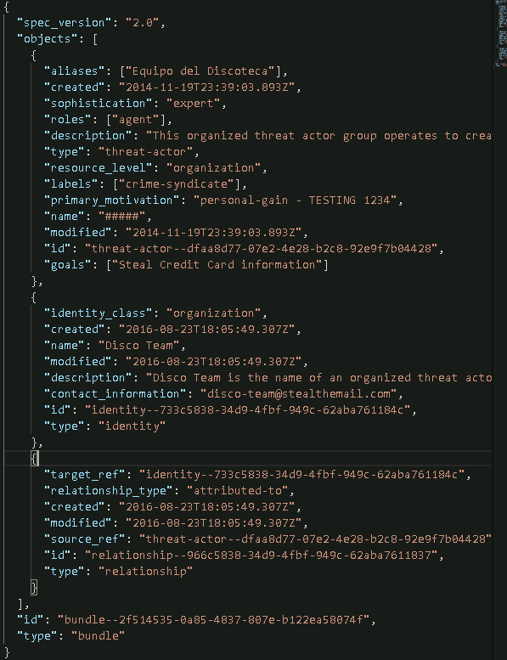

Slide 6
High level flow of HR Yellow Dog App.
A Stix Document (with marking) inserted to a queue
Backend ingests the doc and parse for HR fields
Doc and HR fields are saved in DB
User pulls HR, reviews & disseminates
Backend disseminates the modified Stix doc
Modified doc is now available for partner

Slide 7
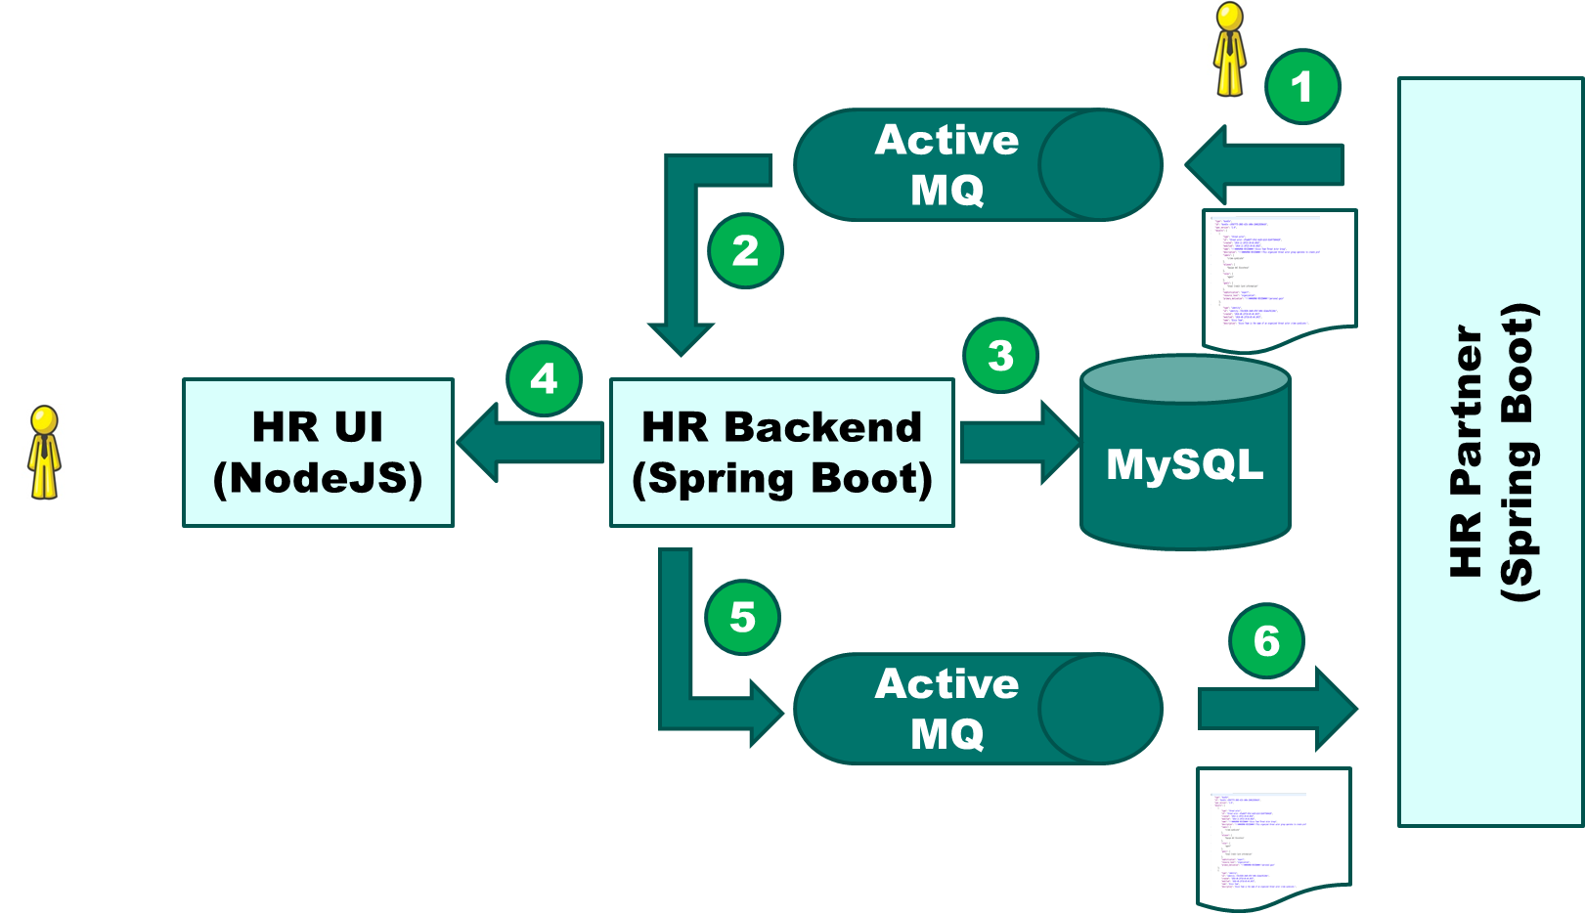
Unit tests with JEST (87%+)
Unit tests with Junit (93%+)

Slide 8
Web Driver Interactions
REST API Interactions
HR UI Automated Tests
(Java – Serenity/Cukes – Selenium Web Driver – REST API)

Slide 9
REST API Interactions
REST API Interactions
HR Backend (API) Automated Tests
(Java – Serenity/Cukes –REST API)

